Slide 1
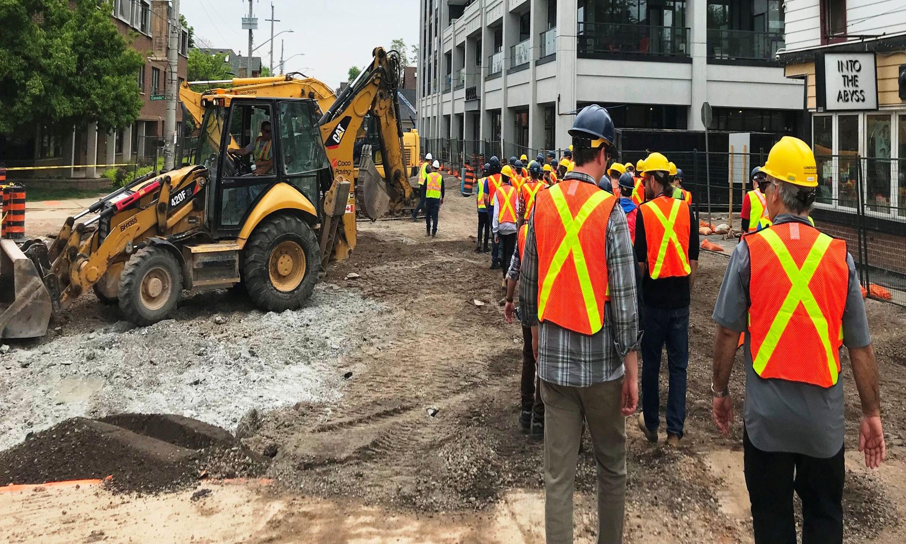
Coco Paving
Locke Street Reconstruction

Slide 2
Coco Paving Locke Street Reconstruction

Slide 3
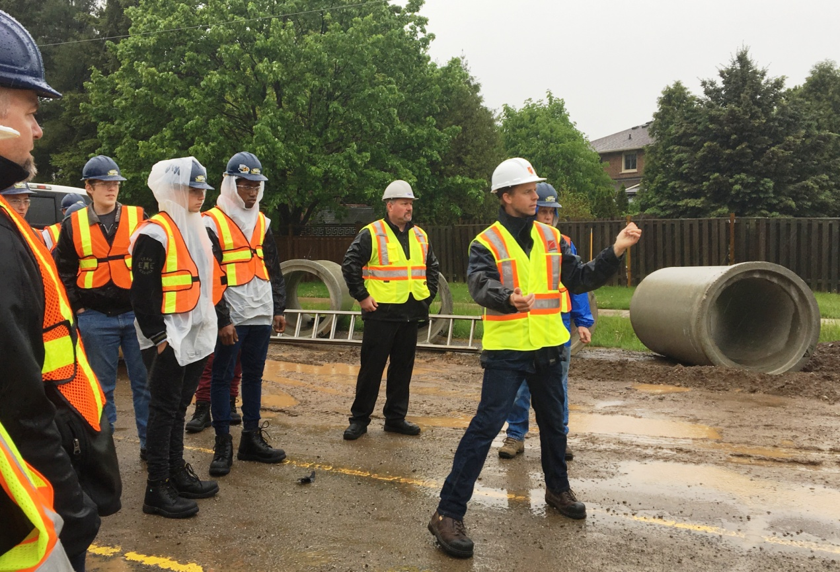
Coco Paving Locke Street Reconstruction

Slide 4
Pita Pit Lunch & Skilled Trade Promotion Presentations

Slide 5
Ipex Tapping Machine Display

Slide 6
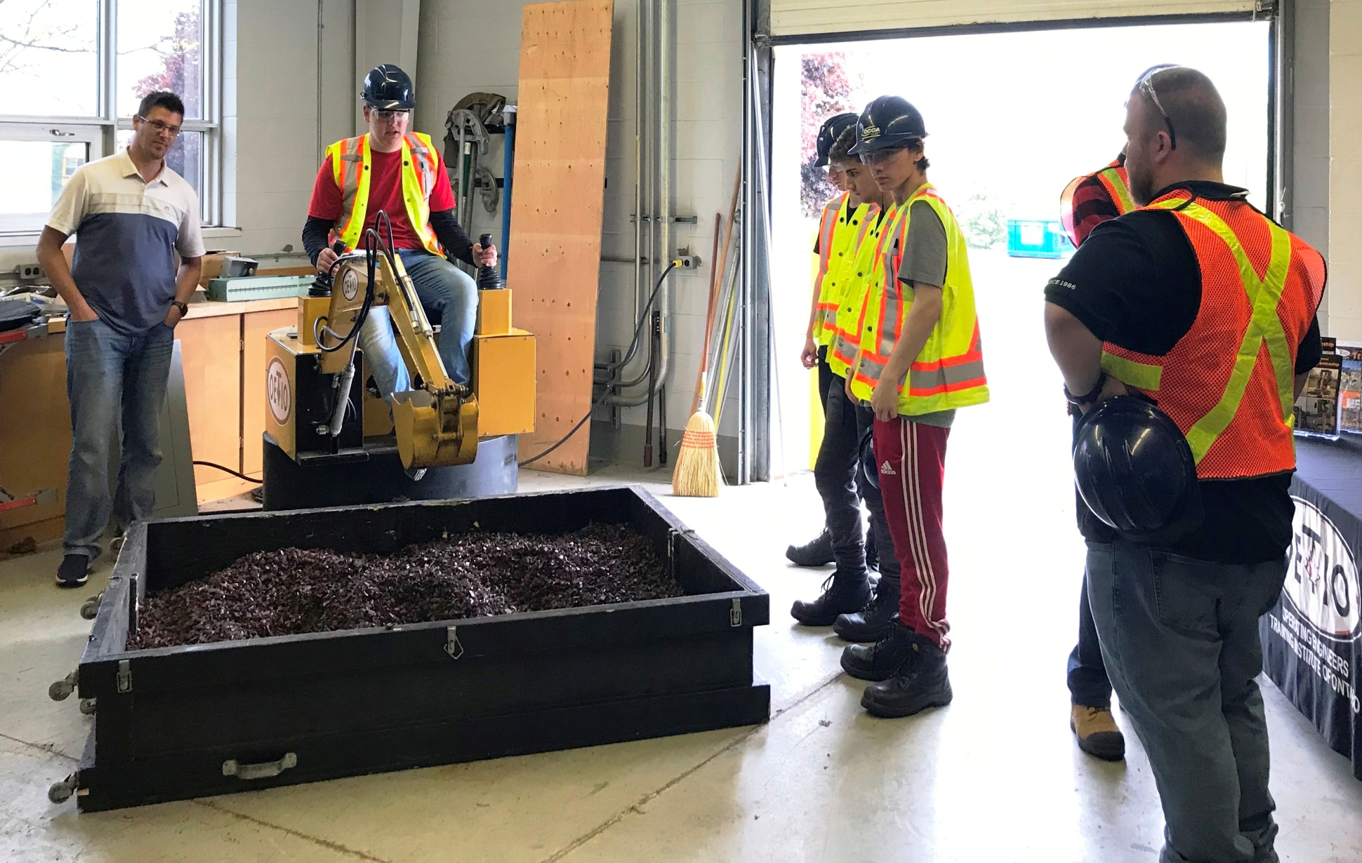
Operating Engineers Heavy Equipment Simulator

Slide 7
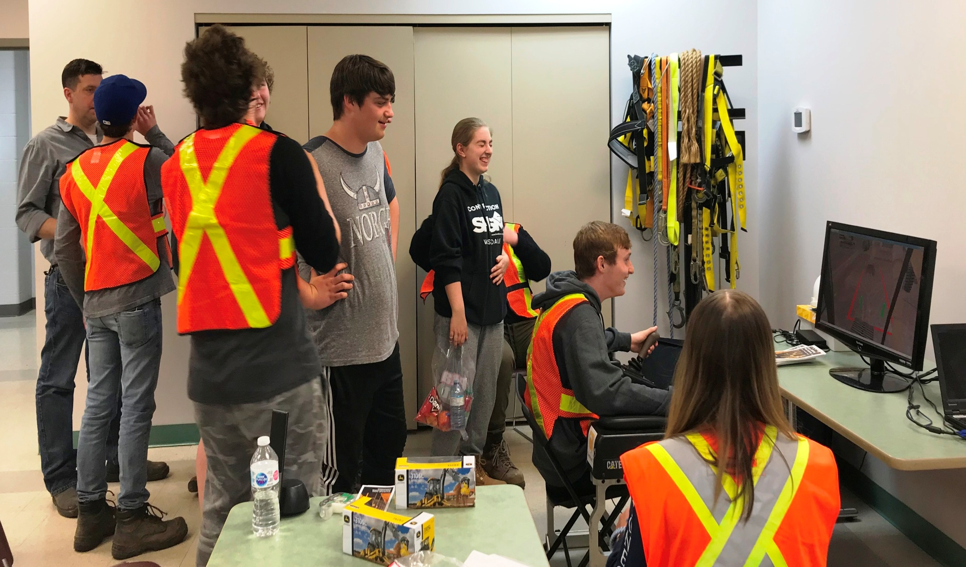
Heavy Equipment Simulator

Slide 8
Lafarge Ready Mix Plant Tour

Slide 9
8th High School
Construction Day
HAMILTON Public
School Board 2019
The End

